Slide 1

HOMOVERSEAS
“We provide homes for wherever you are”
Suni Yao, Shuhan Zhao, Juncheng Cao, Runqing He

Slide 2


CONTENT
For Uniqueness, Feasibility, Profitability, Sustainability and Social Benefits.
PART ONE
Introduction
PART TWO
For Product, Promotion, Price and Place.
CREW
PPT and rationale writing: Shuhan Zhao
Product, UI Design and PPT: Suni Yao
Price and Poster: Junchen Cao
Place Promotion: Runqing He
Marketing Mix

Slide 3
Introduction
Of
“Homoverseas”
01
Under the international trend of studying abroad, we aims to provide comfortable and convenient homestay platform over wide ranges of countries.
—— Business Idea ——

Slide 4

Business Striking Points
Personalized Classification
Two-way Selection
Stars ranking system: customers can see credit and comment of a host in transparency
Communicating channel: private space for getting into know each other, providing the right to choose the right
Searching box: countries, cities, and universities
Various tag hints: from aspects of age, genders, price, house type etc.
Comfortableness & Timeliness
Detailing Information
- Local malls, nearby universities and the time needed to walk there
- Detailed information about the host: to find the one who fits the most
Clean pages and introductory instructions
Fast dealing speed, efficient selections decent service attitude

Slide 5

Profitability
Agency Fee
By providing homestay service for oversea students, we deduct a percentage of the sum of money during the trade.
Commercial Advertising Space
Additional space of our app is available for advertisement of apps, websites and products from other brands which will be proper without interference of the use of normal function.

Slide 6

Sustainability and Social Benefits
Sustainability
- our customers are overseas students all over the world - customer base
- solve the initial finance problems by business strategy
Social Benefits
-provided overseas students all over the world a platform to find their homestay which suits them best

Slide 7
Product
2.1
Brand name
Brand logo
APP pages & functioning
—— Product ——

Slide 8


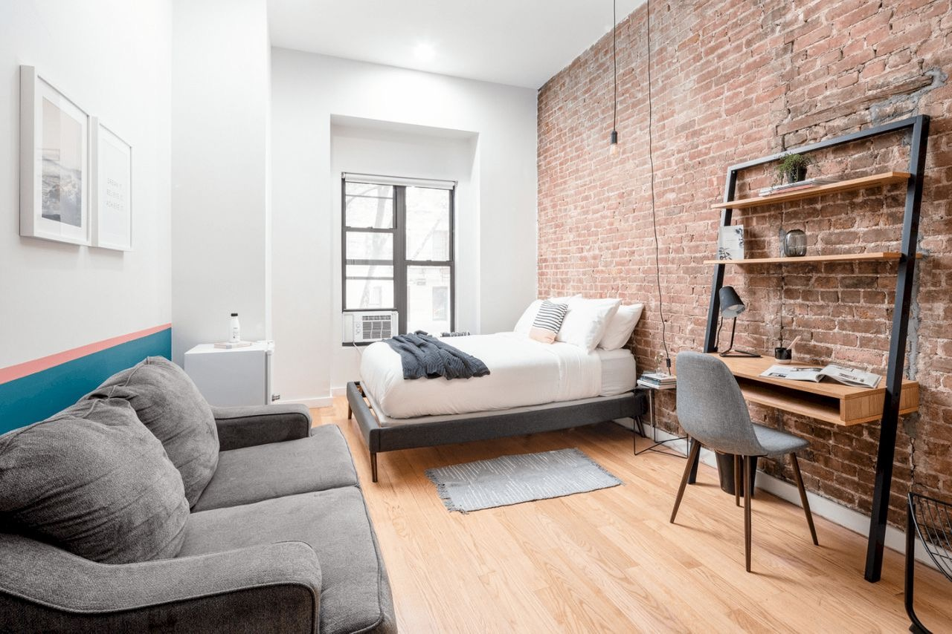
Product
Blue:
Bright, fresh, smooth
Meaning comfortable and trustworthy
BRAND LOGO!
We provide homestay service!
Home image:
“We provide home for wherever you are”
Shape like a shelter, meaning comfort and protection

Slide 9


3 STEPS for Booking a Host Family
Talk to your Landlord
Chat with your host in our communicating channel to get to know him/ her better.
Search for Homestay
Room Reservation
Look for host families in your city or near your school.
Securely lock the housing through online payment.

Slide 10

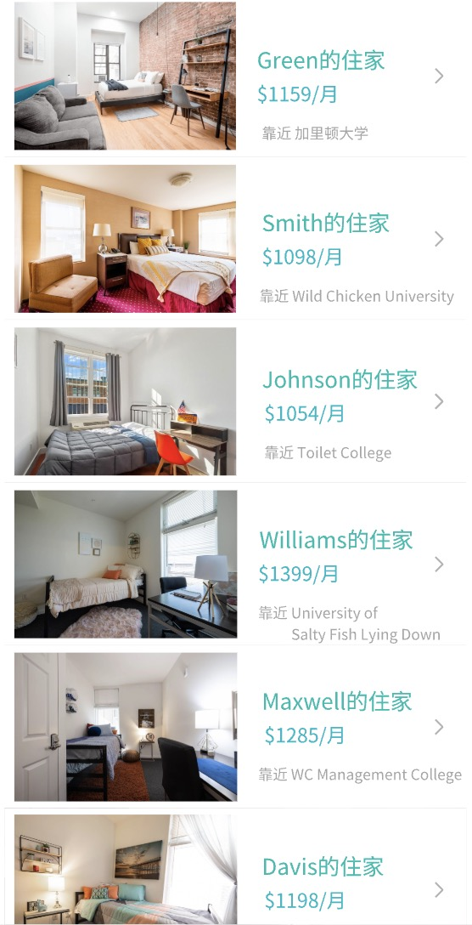


v
3 STEPS FOR BOOKING A HOST FAMILY:
Step 1: Search for homestay
Countries & Regions
E.g. America, Canada, England, Los Angeles…
Universities
E.g. Brown University, Yale University, Imperial College London…
Price Range
Price from high to low
E.g. Less than 1000, from 1000 to 5000, over 5000…
Price from low to high

Slide 11
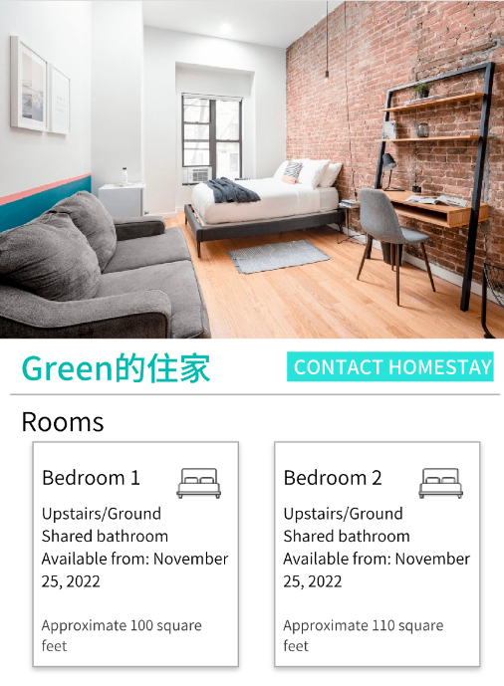
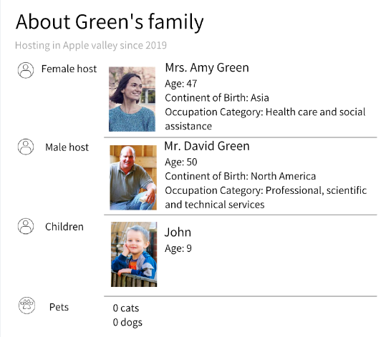
Green’s host family

Slide 12
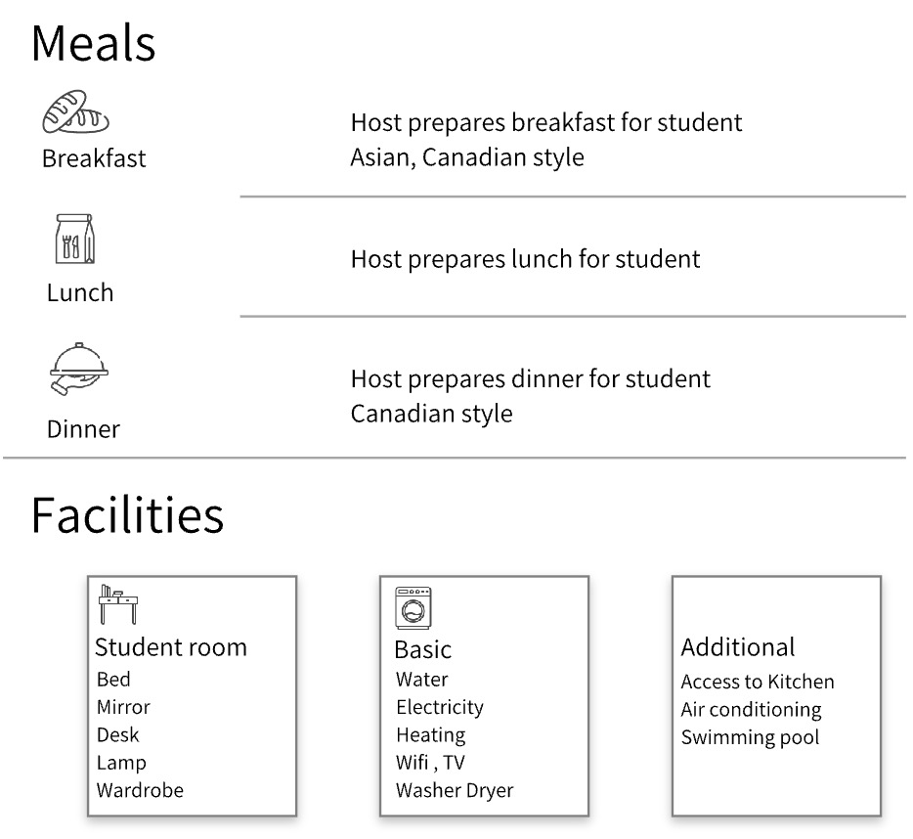

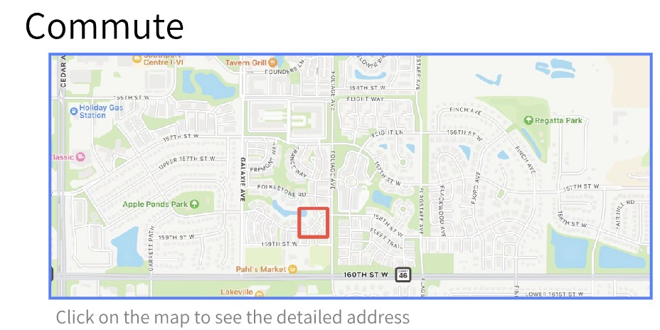
Green’s House

Slide 13
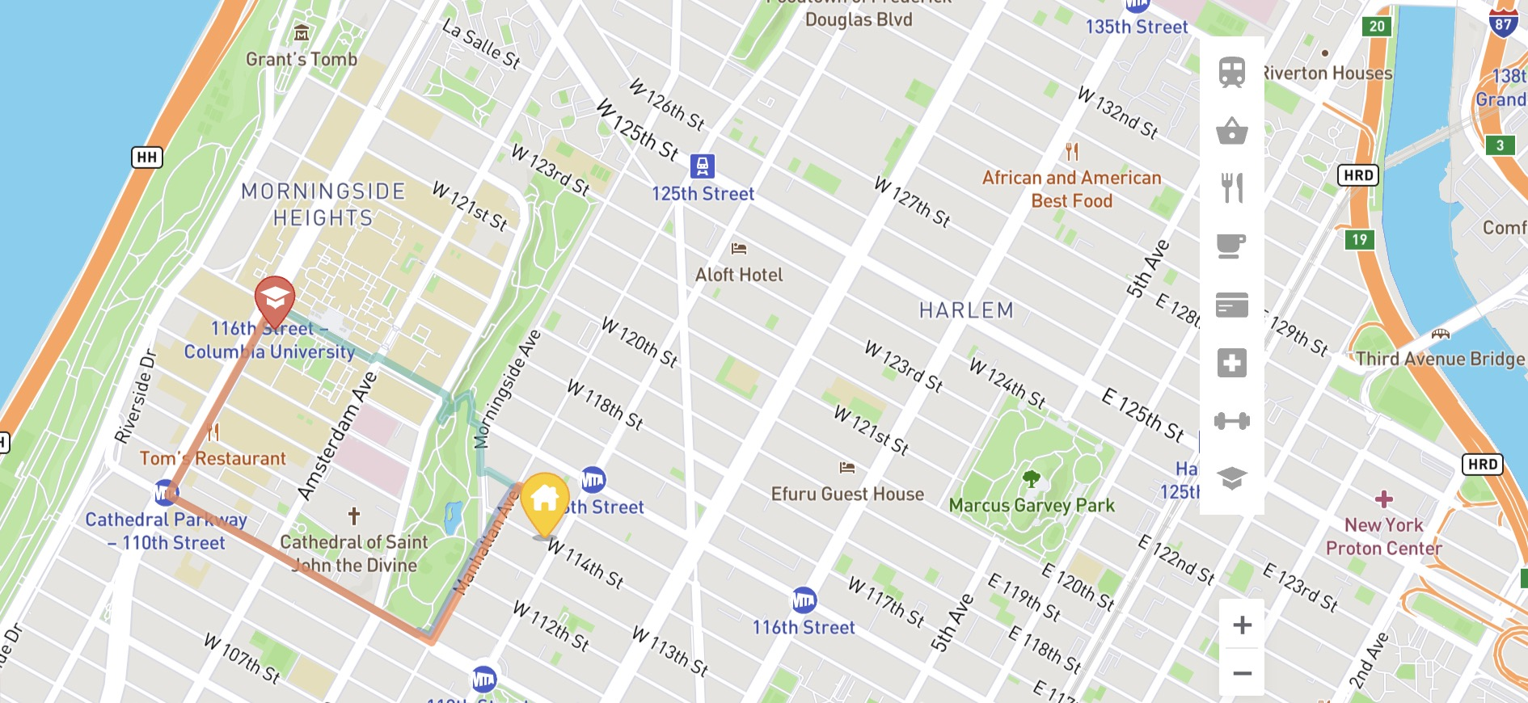
ADD YOU TITLE IN HERE
Details included in the page
Host’s nation, age, families, preferences & rules
Transportation, shopping malls, restaurants, cafeterias, companies, hospitals, gym, schools nearby (and time to get there).
Furniture, security safeguard, number and types
of rooms (with pictures)

Slide 14

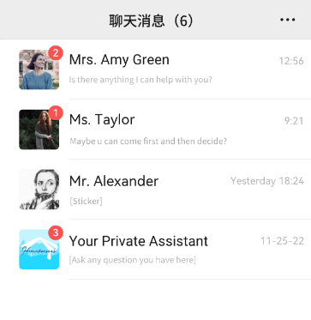

3 STEPS FOR BOOKING A HOST FAMILY:
Step 2: Talk to your landlord
Mr. Green’s House
America
Hi, I’ the host Mr. Green
Hi, I’m Arena. I want to know more about your location.
Talk to your landlord
Chat with your host in our communicating channel to get to know him/ her better.
Okay, what about calling on phone?
Search for Homestay
Look for host families in your city or near your school.
That will be Great!

Slide 15


3 STEPS FOR BOOKING A HOST FAMILY:
Step 3: Room reservation
Personalized counseling service
We provide one-to-one consulting service for answering questions and advising suggestions about college entrance questions, nearby environment or security standard, entertainments as well as rental guide for certain university or regions.
House Viewing service
We also provide offline home viewing service to company and help customers find their ideal homestay.

Slide 16
Price
2.2
Strategies we will use at different business stages
Penetration
Cost plus
Skimming
—— Price ——

Slide 17



PRICE
01.
Penetration
Download Fee: free!
when we first set up this APP and put into the market
Adv:
attract both willing hosts and tenants from our competitors since it’s at a lower price
create brand awareness
increase our market share rapidly by several promotion strategies
Advertisement space:30 RMB per month
Agency Fee: deduct 15% from both sides

Slide 18
PRICE
02.
Cost Plus
Download Fee: 5 RMB
Advertisement space:
100-800 RMB per month
When customer base is guaranteed
for functions and service’s fee increasing (membership & agency fee)
Adv:
easy and quick to calculate
ensure our APP’s daily profits
03.
Skimming
- for commercials and advertisements space
Adv:
- recover R&D costs quickly
- create a qualified image for our customers
Agency Fee:
deduct 25-35% from both sides

Slide 19
Place
2.3
From different perspective, we have different place.
producer
retailer
—— Place ——

Slide 20

PLACE
As service provider
Specialized service
(counseling & house viewing)
producer to customer
As agency
intermediary agent
retailer between the host and the customer

Slide 21
Promotion
2.4
Above-the-line promotion
Below-the-line promotion
—— ways & advantages
—— Promotion ——

Slide 22
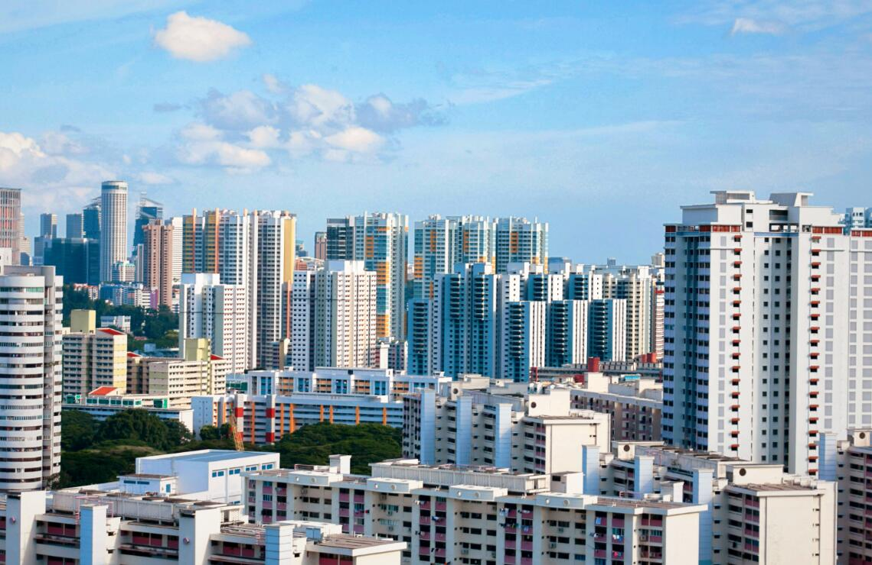
Above-line Promotion
Ways:
Invite people around us to experience our service for free and let them send videos on social media like Tiktok, Twitter，Little Red Book…
Find Bloggers/Vloggers overseas, pay for implant advertisement

Slide 23




Above-the-line Promotions
Advantages:
Cost effective
Big data will help us to deliver the video to the right group
The video may include personal experience, it is more persuasive.

Slide 24
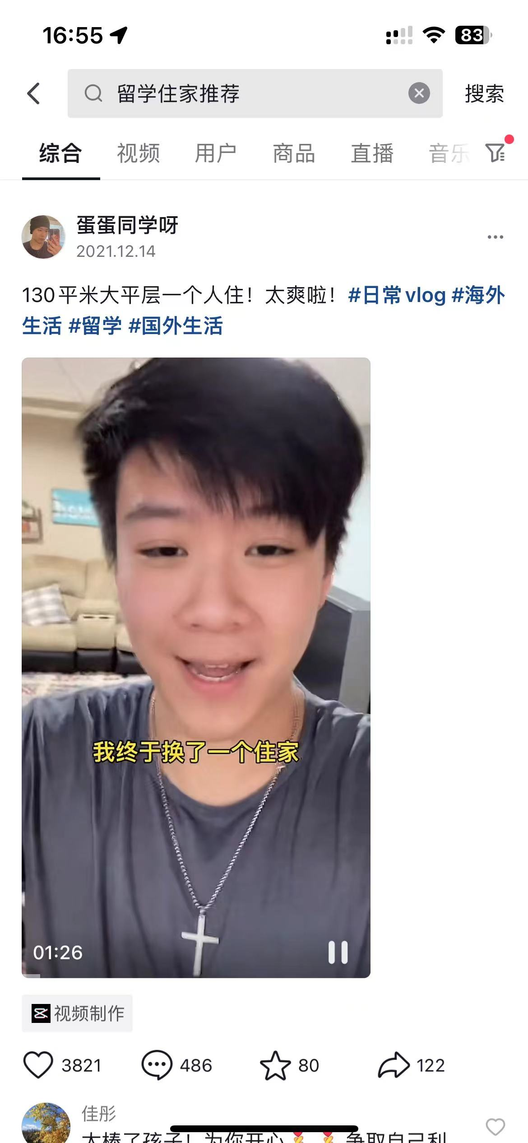
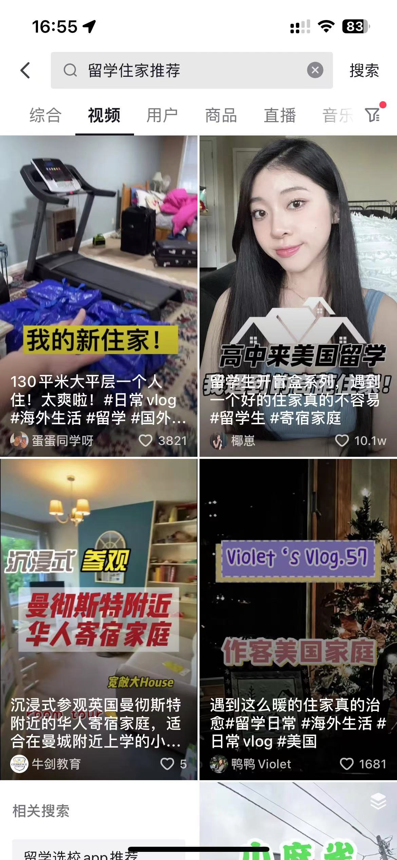
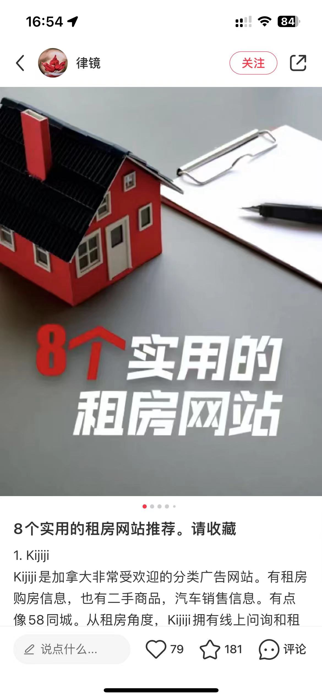
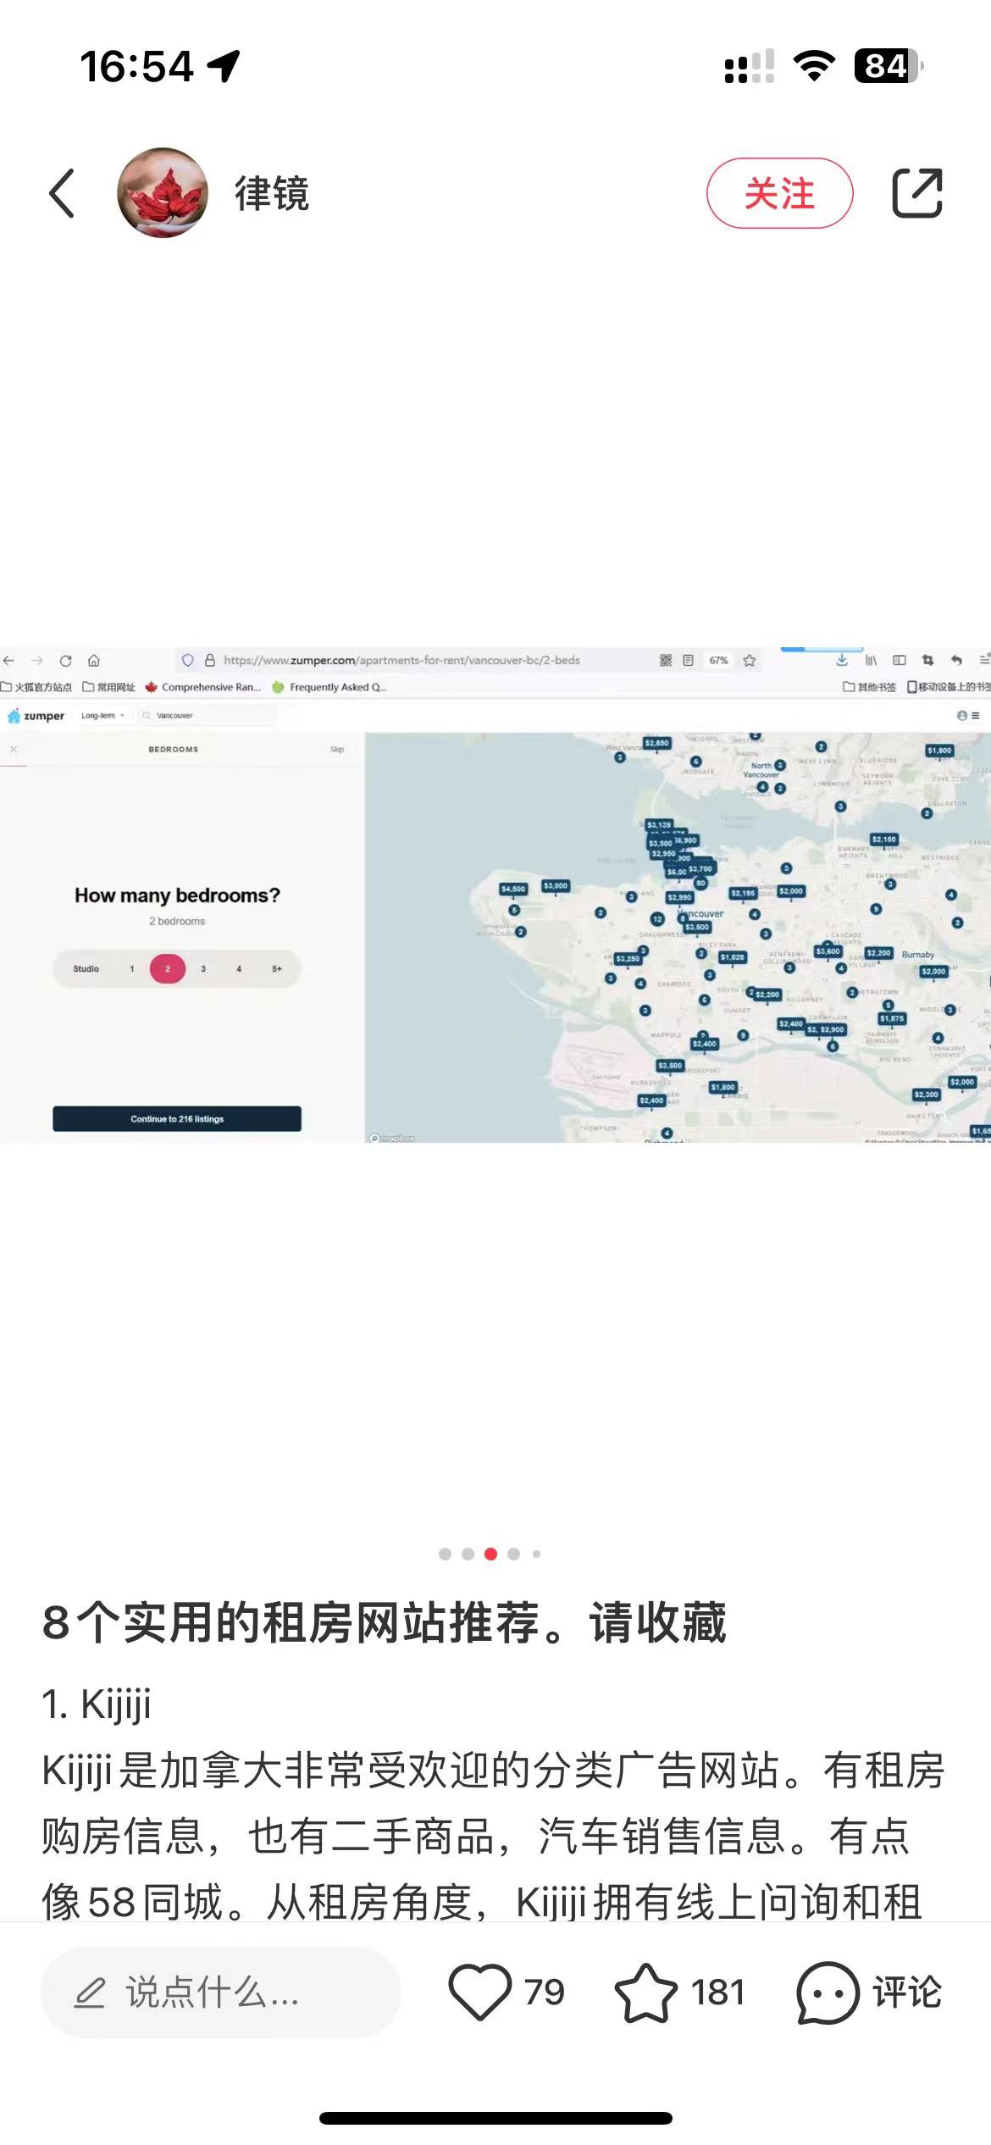
姐妹们墙裂安利这个Homoverseas APP, 里面的房源真的超多, 咨询师一对一服务也很良心很负责, 而且这个界面也太戳我了8! 留学的集美冲冲冲!

Slide 25
Below-the-line Promotion
Ways
For Promotion
By inviting new user, customers can get discount coupons
2. For the first-use user, extra service would be provided
3. Using e-mail to deliver advertisements.

Slide 26
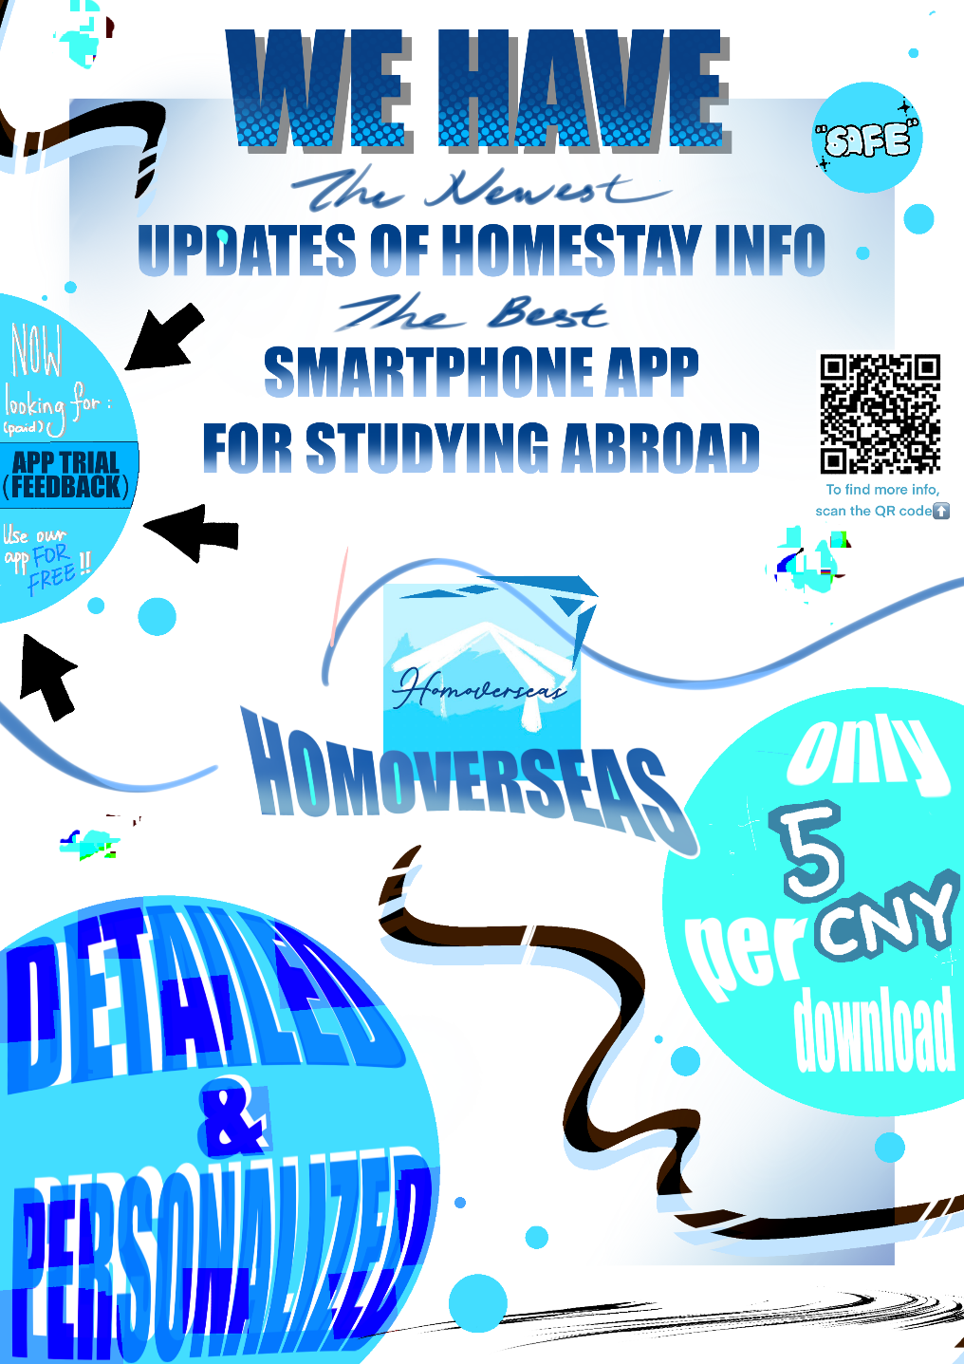
Promotion poster

Slide 27
THANKS
“We provide homes for wherever you are”
Suni Yao, Shuhan Zhao, Juncheng Cao, Runqing He

